Slide 1
Group 3 Final Project
By Puttanun Ukhampun & Ramita Ladee

Slide 2
Task allocation
Week 1 | Week 2 | Week 3 | Week4 | Week5 | Week6
Extract data (Earth & Ta) |  | Summary table (Earth) |  | Combine modules (Earth) | Debugging (Earth & Ta)
 |  | Features (Ta)
How to collaborate
Our group only have two members. We use slack chat box to communicate
Drawback: slack chat box has limited line.
Solution: send via notepad file or using github
1

Slide 3
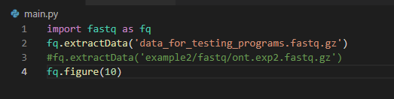
Our program
Download
Github: https://github.com/puttanun120641/fastq_project
Run
Dowload the fastq file sample its destination
Write the following commands
File name
PHRED Cut-off level
2

Slide 4
Overall workflow
Prepare data
Study fastq format
Extract data
Using regular expression
Transform from fastq format into list of list for every parameter of interest
Create data frame
Using pandas
Store data frame
Store as pickle dataframe
Develop feature
Graph & Plot
Summary table
Test & debugging
Using google collab
3

Slide 5
Summary table workflow
Fastq format
Using regular expression
Whole data frame
Extract pass read
All read data frame
Pass read data frame
General & basecall summary table
Convert table to HTML
4

Slide 6
Summary table
Using regular expression to extract the data of interest
content = str(seq_record.description)
runid = re.search(r'runid=(\w+)', content)
barcode = re.search(r'barcode=(\S+)',content)
Create whole data frame
id | Run id | Readlength | Phred_quality | barcode
seq_record.id | runid.group(1) | len(seq_record.seq) | numpy.median(seq_record.letter_annotations["phred_quality"]) | barcode.group(1)
5

Slide 7
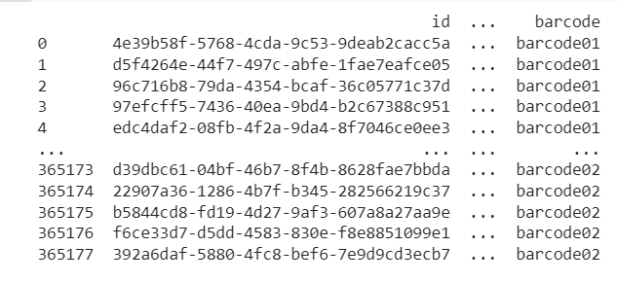
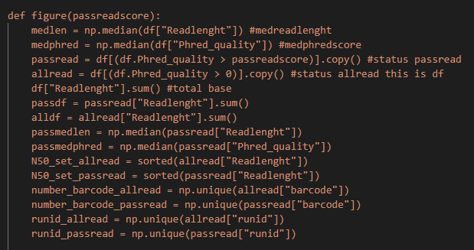
Summary table
Create allread and passread data frame from the whole data frame
allread = df[(df.Phred_quality > 0)].copy()
passread = df[(df.Phred_quality > passreadscore)].copy()
6

Slide 8
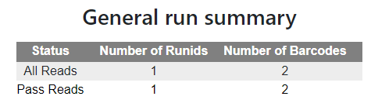
Summary table
Input
&
Parameters
General run summary | Input | Parameter
Number of run ID | Number of all run ID | np.unique(allread["runid"]) len(runid_allread)
 | Number of pass ID | np.unique(passread["runid"]) len(runid_passread)
Number of barcode | Number of all barcode | np.unique(allread["barcode"]) len(number_barcode_allread)
 | Number of pass barcode | np.unique(passread["barcode"]) len(number_barcode_passread)
Output
7

Slide 9
Summary table
Input & Parameters
Basecall summary | Input | Parameter
Number of read | Number of all reads | len(allread)
 | Number of pass read | len(passread)
Number of bases | Number of all bases | allread["Readlenght"].sum()
 | Number of pass bases | passread["Readlenght"].sum()
N50 (Using define function) | N50 of all reads | calculate_N50(allread["Readlenght"])
 | N50 of pass reads | calculate_N50(passread["Readlenght"])
8

Slide 10
Summary table
Input & Parameters
Basecall summary | Input | Parameter
Median read length | Median read length of all read | np.median(df["Readlenght"])
 | Median read length of pass read | np.median(passread["Readlenght"])
Median PHRED score | Median PHRED score of all read | np.median(df["Phred_quality"])
 | Median PHRED score of pass read | np.median(passread["Phred_quality"])
9

Slide 11
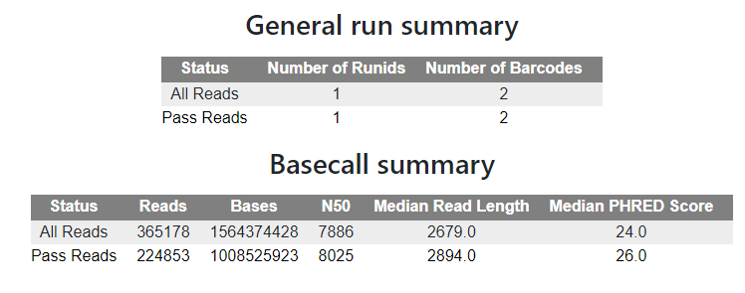
Summary table
Convert summary table to HTML format
Using pretty html table
Output
10

Slide 12
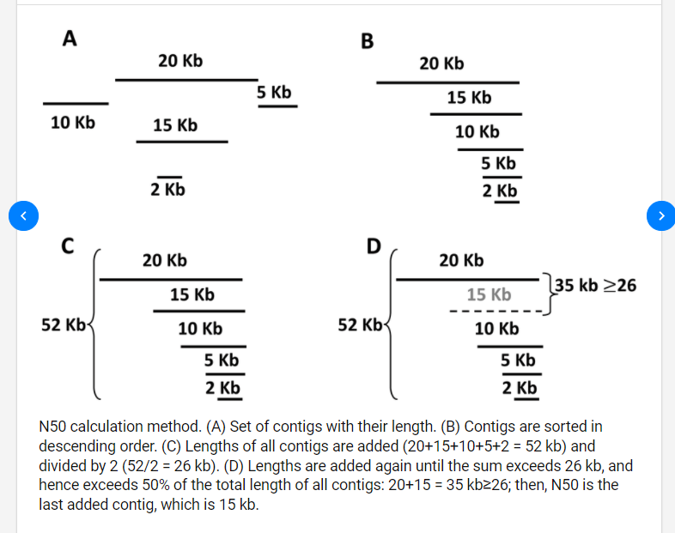
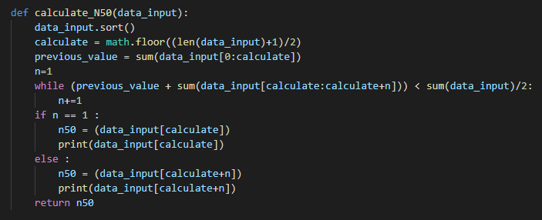
N50 calculation
https://www.researchgate.net/figure/N50-calculation-method-A-Set-of-contigs-with-their-length-B-Contigs-are-sorted-in_fig22_259354298
11

Slide 13
N50 calculation
[ 1, 2 , 3 , 4 , 5 , 6 , 7 , 8 , 9 ]
Sum = 45
Med position = calculate = 5 (0-based)
preV = 1+2+3+4+5 = 15
1st loop : preV + [5:6] = 15 + 6 = 21 < 22.5 ; True
2nd loop : preV + [5:7] = 15 + (6+7) = 28 < 22.5 ; False
Print 7th ( position calculate + n = 5+2 = 7 ) = 6

Slide 14
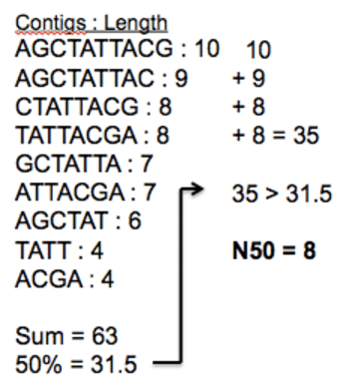
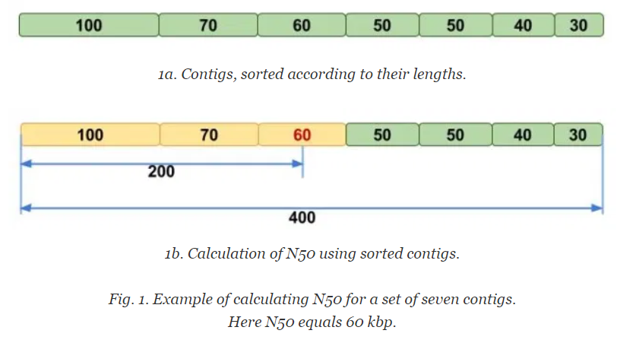
N50 calculation

Slide 15
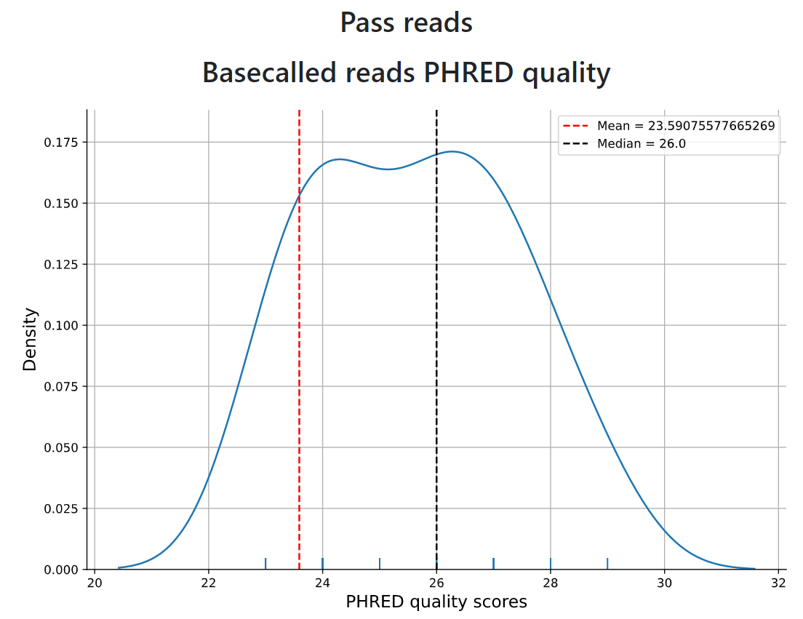
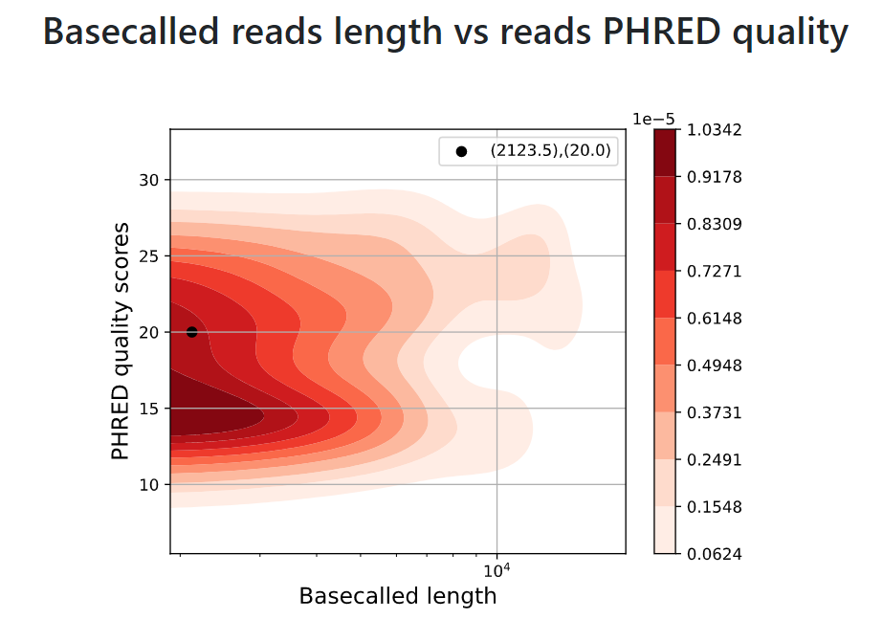
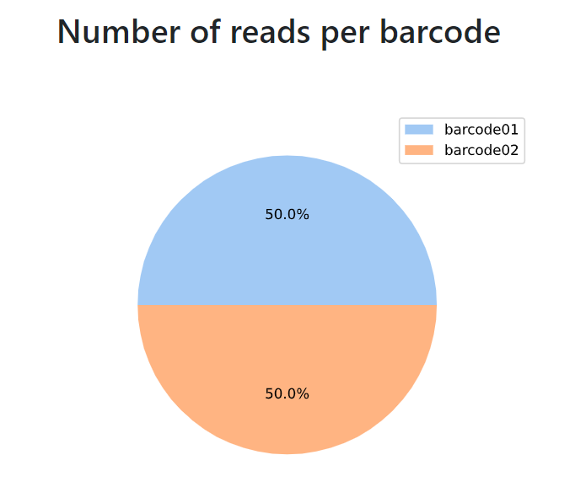
Features workflow
Pandas Dataframe
Seaborn & Matplotlip
Graph
Density plot using seaborn.displot
2D density plot using seaborn.kdeplot
Pie chart using Matplotlib.pie
plt.axvline of mean and median(df.mean,median)
plt.xlim
plt.scatter(x=medlen, y=medphred)
plt.xscale('log')
12

Slide 16
Features
Input & Parameters
Univariate distribution(1D) | Input data | Parameters
Basecalled reads length | All reads.dataframe | Data = df[“Readlenght], X = Readlenght, Kind = kde, Hight, Aspect
 | Pass reads.dataframe | Data = passread[“Readlenght], X = Readlenght, Kind = kde, Hight, Aspect
Basecalled reads PHRED quality | All reads.dataframe | Data = df[“PHRED quality“], X =PHRED quality, Kind = kde, Hight, Aspect
 | Pass reads.dataframe | Data = passread[“PHRED quality”], X = PHRED quality, Kind = kde, Hight, Aspect
13

Slide 17
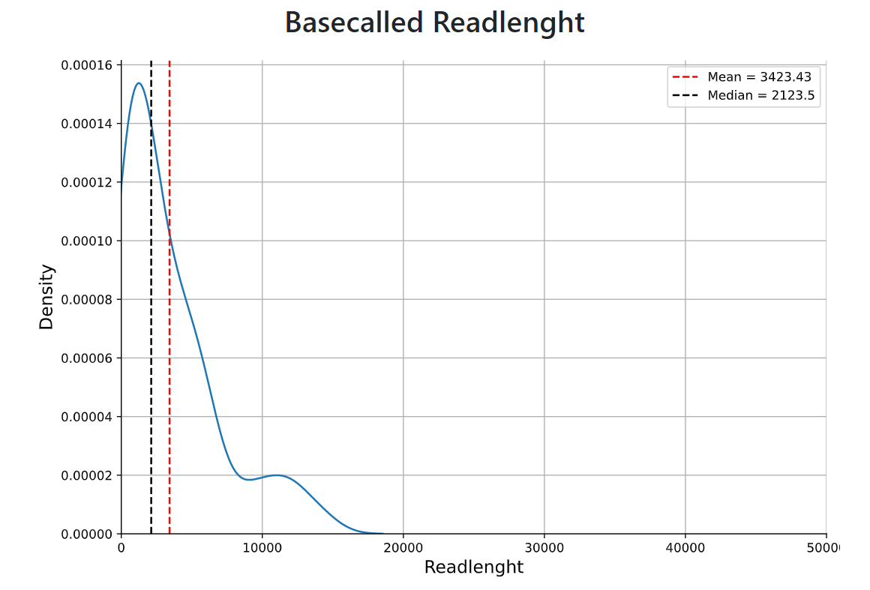
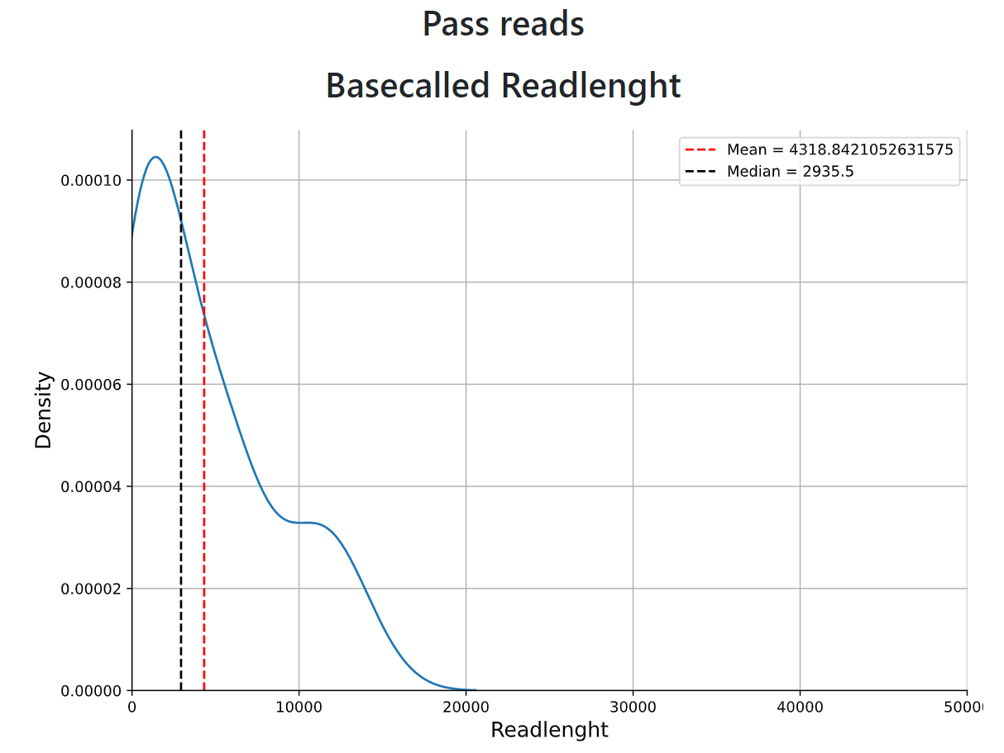
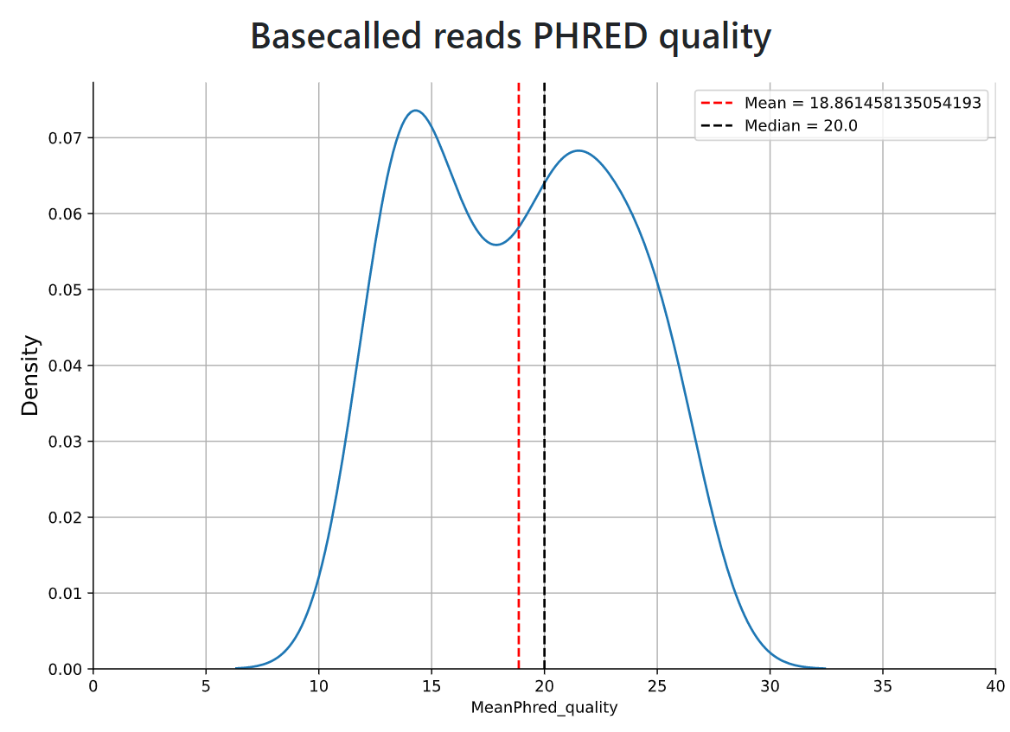
Features
Output of univariate feature
14

Slide 18
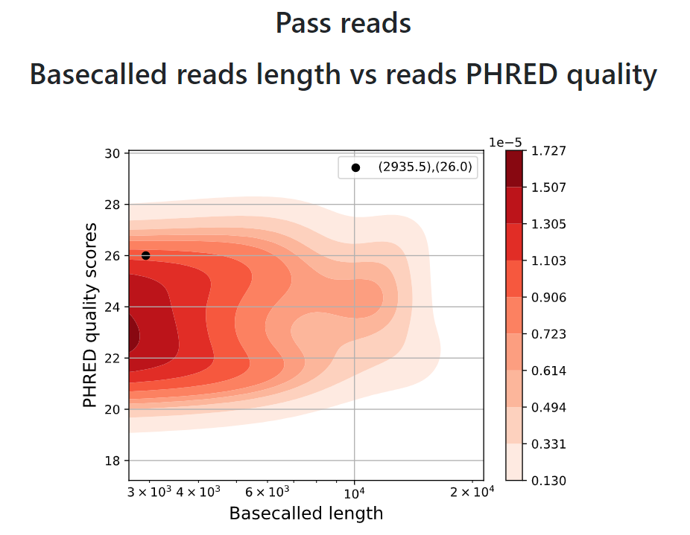
Features
Input & Parameters
bivariate distribution(2D) | Input data | Parameters
Basecalled reads length & Phred quality scores | All reads.dataframe | x=df.Readlenght, y=df.MeanPhred_quality, cbar=True, cmap="Reds", shade=True, bw_adjust=1
 | Pass reads.dataframe | x= passread.Readlenght, y= passread.MeanPhred_quality, cbar=True, cmap="Reds", shade=True, bw_adjust=1
Output
15

Slide 19
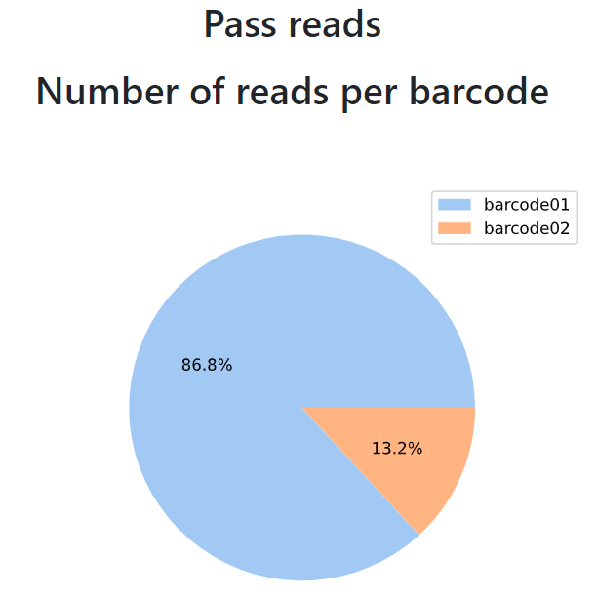
Features
Input & Parameters
Pie chart | Input data | Parameters
Basecalled reads length & Phred quality | All reads.dataframe | df["barcode"].value_counts() labels = list(df["barcode"].unique()) pie(tools, colors = colors, autopct='%.01f%%’)
 | Pass reads.dataframe | passread["barcode"].value_counts() labels =list(df["barcode"].unique()) pie(tools2, colors = colors, autopct='%.01f%%')
Output
16

Slide 20
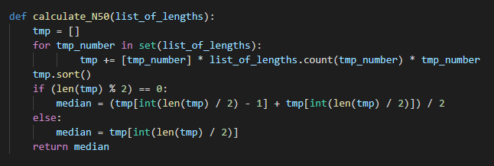
Debugging
Bug
Debug
Using the unfamiliar code
It works only with the small file
,But large file it will not
Writing the code that we really understand
17

Slide 21
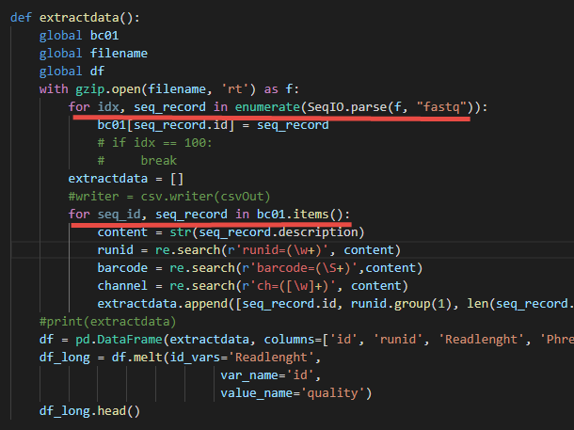
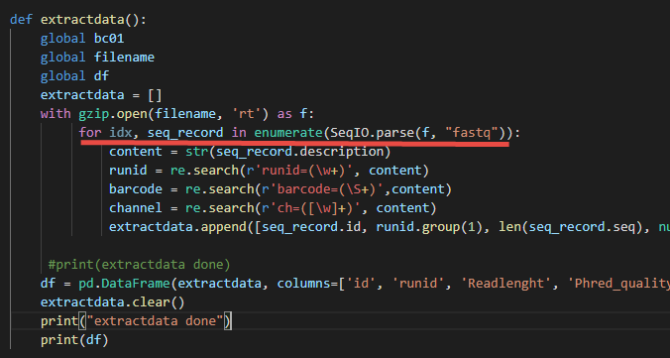
Debugging
Bug
Debug
Double for loop
Remove the redundant one
18

Slide 22

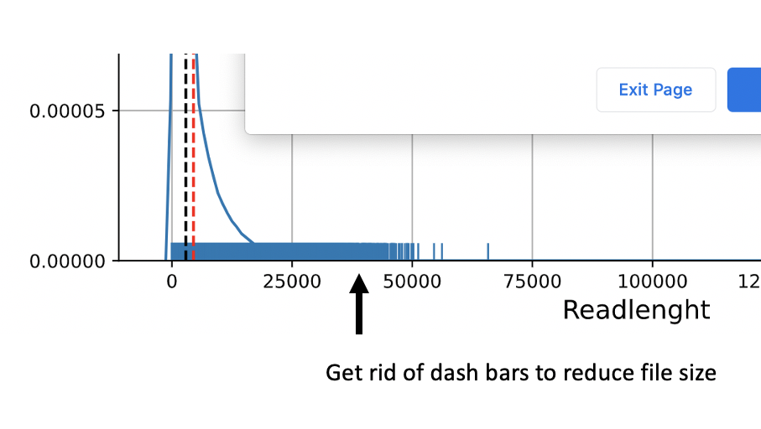
Debugging
Bug
Debug
Too large file size
Remove rug plot
19

